Slide 1

Introduction to Classification
Martin Gordon Mubangizi
UN Global Pulse Lab Kampala
Data Science Africa 2018, Abuja
Notes:
My name is Martin Gordon Mubangizi, I work with Pulse Lab Kampala but also belong to the Artificial Intelligence Lab at Makerere University. Today we shall be talking about classification.
Thank the organizers, NMIST, Ciira, Dina

Slide 2
Introduction
Making sense of the World…

Slide 3

Introduction
Making sense of the World…
Notes:
To a baby every thing is new, strange, even the parents are strange - there is a lot to make sense of - it is just the beginning

Slide 4

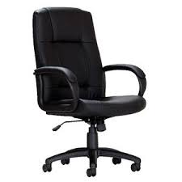
Introduction
Different shape
Notes:
Every thing is new, strange, and comes in different sizes, colors, shapes, texture…

Slide 5
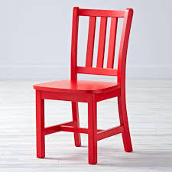
Introduction
Different color
Notes:
Every thing is new, strange, and comes in different sizes, colors, shapes, texture…

Slide 6
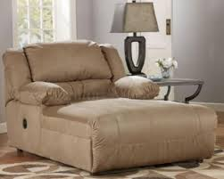
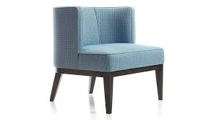
Introduction
Different sizes
Notes:
Every thing is new, strange, and comes in different sizes, colors, shapes, texture…

Slide 7
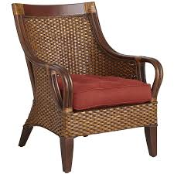
Introduction
Different Textures
Notes:
Every thing is new, strange, and comes in different sizes, colors, shapes, texture…

Slide 8
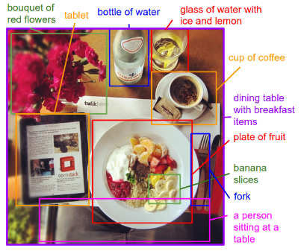
Introduction
We make sense of the world by dividing things up into categories.
Karpathy and Fei-Fei (2014), http://arxiv.org/pdf/1412.2306.pdf
Notes:
Every thing is new, strange, and comes in different sizes, colors, shapes, texture…

Slide 9
Introduction
How do kids get good at identifying chairs, for example.
- exposed to different types of objects that look like chairs,
- take a record of the objects and their corresponding classes:
Chair – positive class and Not chair as negative classes
Notes:
Every thing is new, strange, and comes in different sizes, colors, shapes, texture…

Slide 10

Introduction
Making sense of the World…
Notes:
Every thing is new, strange, and comes in different sizes, colors, shapes, texture…

Slide 11
Introduction
Prepare a Training set :
positive and negative class examples with
Corresponding labels

Slide 12
Introduction
Training set = positive and negative class
examples with corresponding
labels
Design an algorithm or learning techniques

Slide 13
Introduction
Training set = positive and negative class
examples with corresponding
labels
Algorithms examples being : Nearest Neighbor, K-Nearest Neighbor, Neural Networks, Decision trees, SVM

Slide 14
Introduction
Training set + algorithm = Classification model
Training set = positive and negative class
examples with corresponding
labels
Algorithms: Nearest Neighbor, K-Nearest Neighbor, Neural Networks, Decision trees, SVM

Slide 15
Algorithms…
Training set + algorithm = Classification model
Let use a simple example …
x1 = [1,1,1,1,2,2,3,3,4,5,5,6,6,7,7,7,8,8]
x2 = [4,6,8,9,6,8,6,9,3,2,4,4,5,3,5,6,4,7]
Where x1, x2 are features/ attributes of the objects to classify

Slide 16
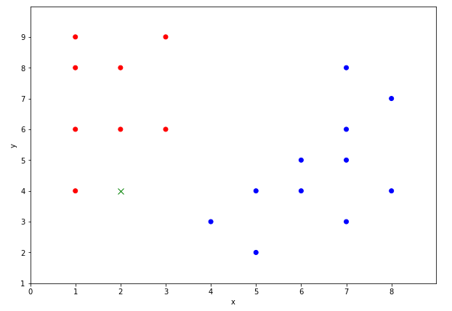
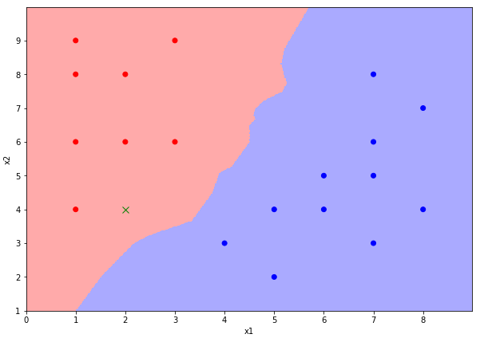
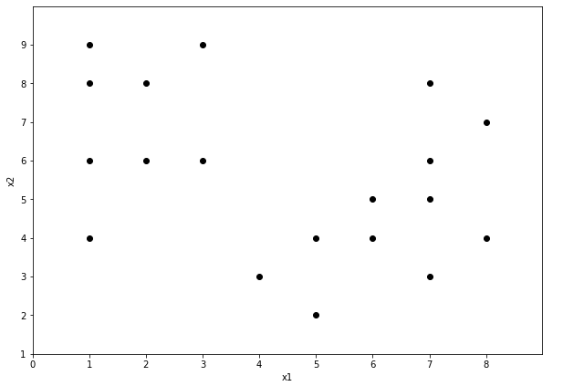

Slide 17
Algorithms…
Training set + algorithm = Classification model
Let use a simple example …
x1 = [1,1,1,1,2,2,3,3,4,5,5,6,6,7,7,7,8,8]
x2 = [4,6,8,9,6,8,6,9,3,2,4,4,5,3,5,6,4,7]
y = [1,1,1,1,1,1,1,1,2,2,2,2,2,2,2,2,2,2]
Where x1, x2 are features/ attributes of the objects to classify
And y is the crossponding class
Notes:
We propose to build an early warning system. The platform will provide alerts in real time on: 1. En route deviation and 2. Delays in time

Slide 18
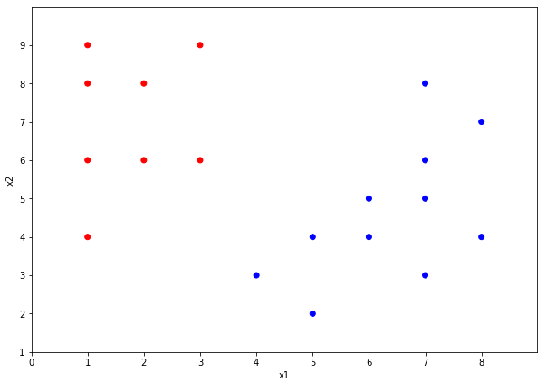

Slide 21
Evaluation Metrics: Confusion Matrix
Actual Class/Predicated Class | C₁ | ~C₁
C₁ | True Positives (TP) | False Negative (FN)
~C₁ | False Positives (FP) | True Negative (TN)
Given m classes, an entry, CM_{ij} in a Confusion matrix indicates # of tuples in
class i that were labeled by classifier as class j

Slide 22
Evaluation Metrics: Confusion Matrix
Actual Class/Predicated Class | Is Chair = Yes | Is Chair = No | _{Total}
Is Chair = Yes | 50 | 7 | 57
Is Chair = No | 10 | 35 | 45
_{Total} | 60 | 42 | 102

Slide 23
Evaluation Metrics: Confusion Matrix
Sensitivity – True Positive Rate = TP/P
A/P | C1 | ~C1
C1 | TP | FN | P
~C1 | FP | TN | N
 | P’ | N’ | All
Specificity – True Negative Rate = TN/N
Accuracy – Recognition Rate
= ( TP + TN)/All
Error Rate: 1 – accuracy, or (FP + FN)/All

Slide 24
Real life Applications
Spam filters
Automatic diagnosis of disease
Roof counting
Counting of white files

Slide 25
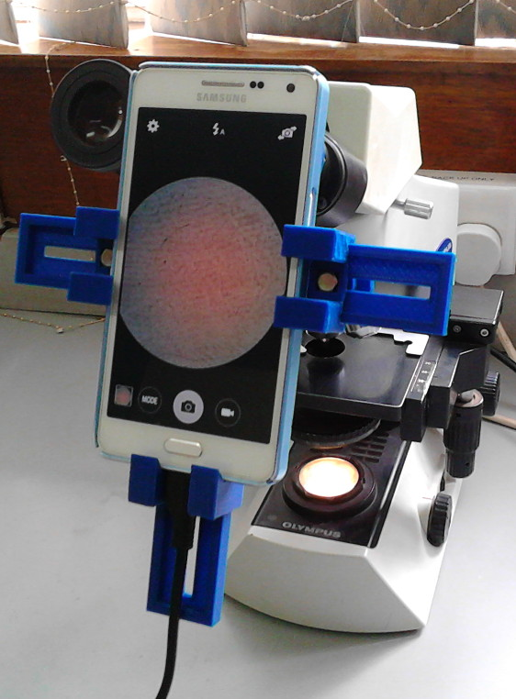
Notes:
We propose to build an early warning system. The platform will provide alerts in real time on: 1. En route deviation and 2. Delays in time

Slide 26
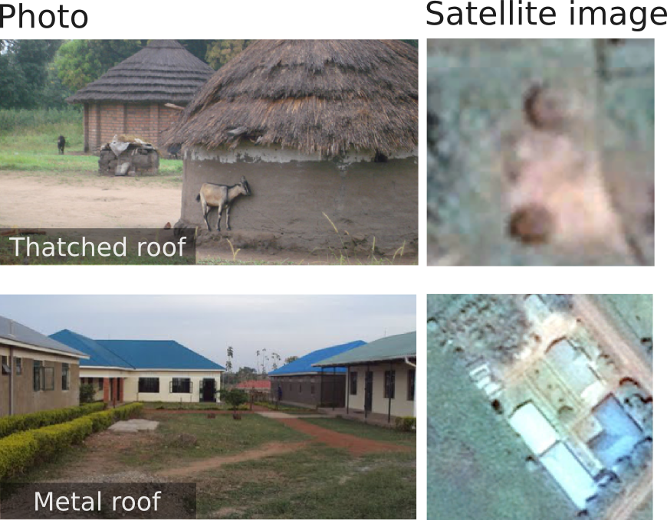
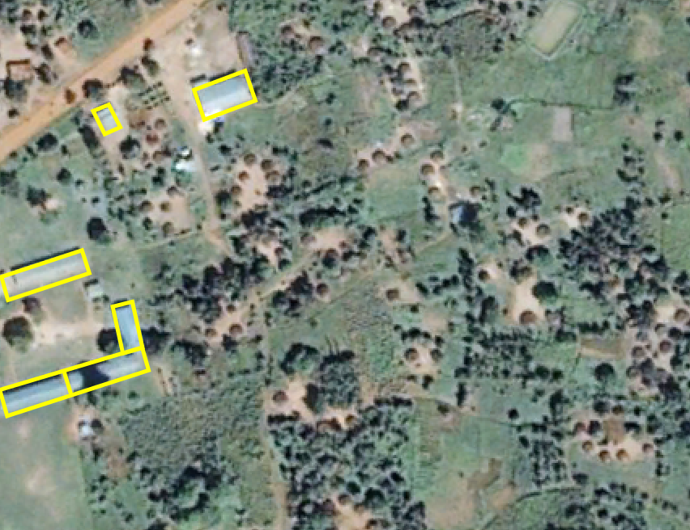
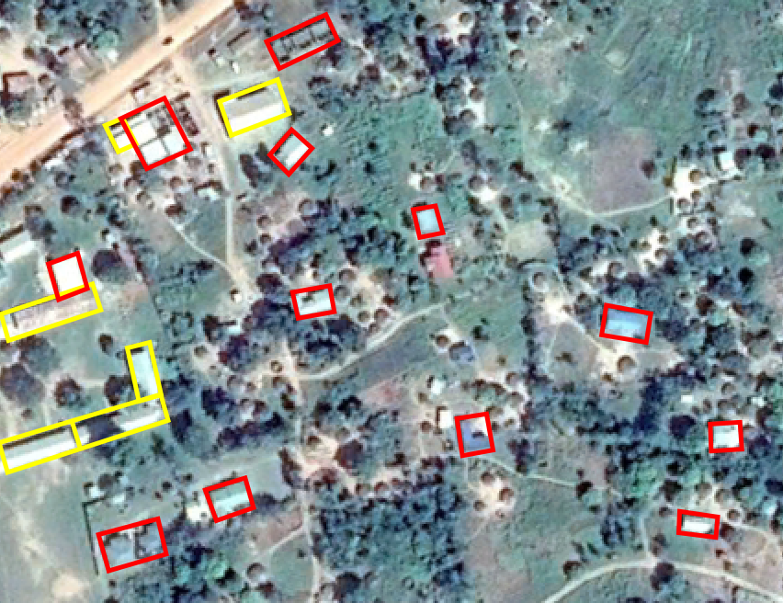
automatic counting

Slide 27
automatic counting

Slide 28
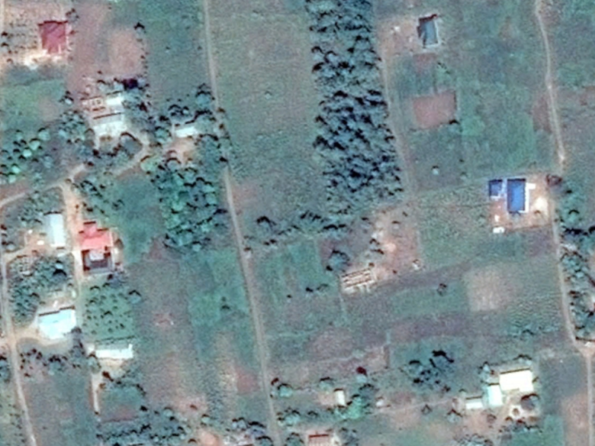
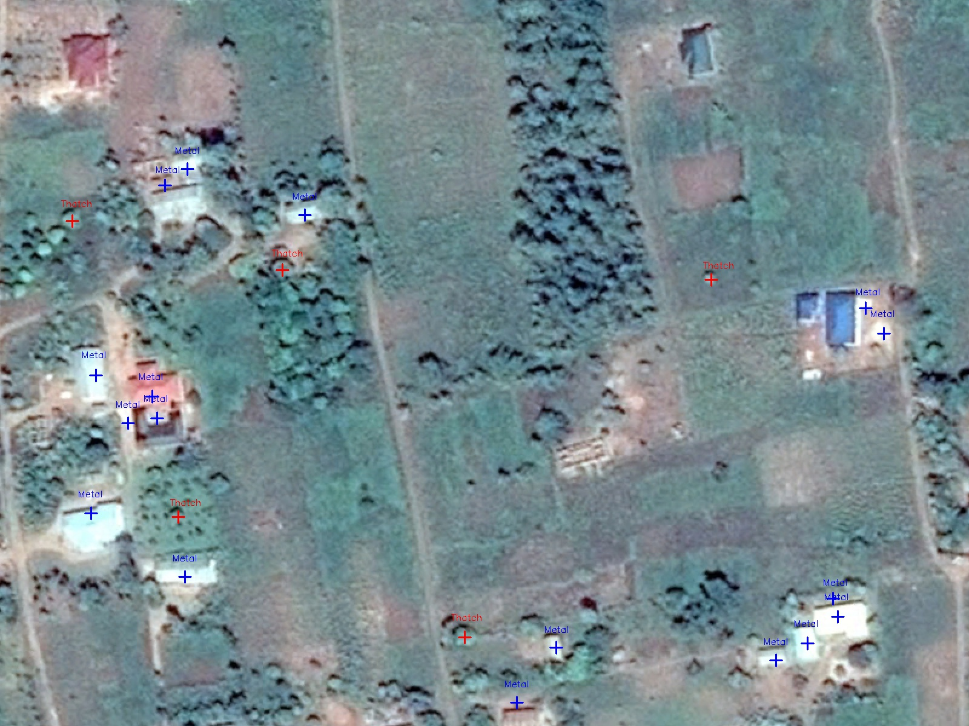
Notes:
Satellite imagery can become a source of Big Data
We have built a tool through machine learning that automatically identifies and counts different types of roofs
The type of roof is a proxy indicator of poverty in Uganda as in many other countries
Government – NPA, UBOS, OPM, UNDP

Slide 29
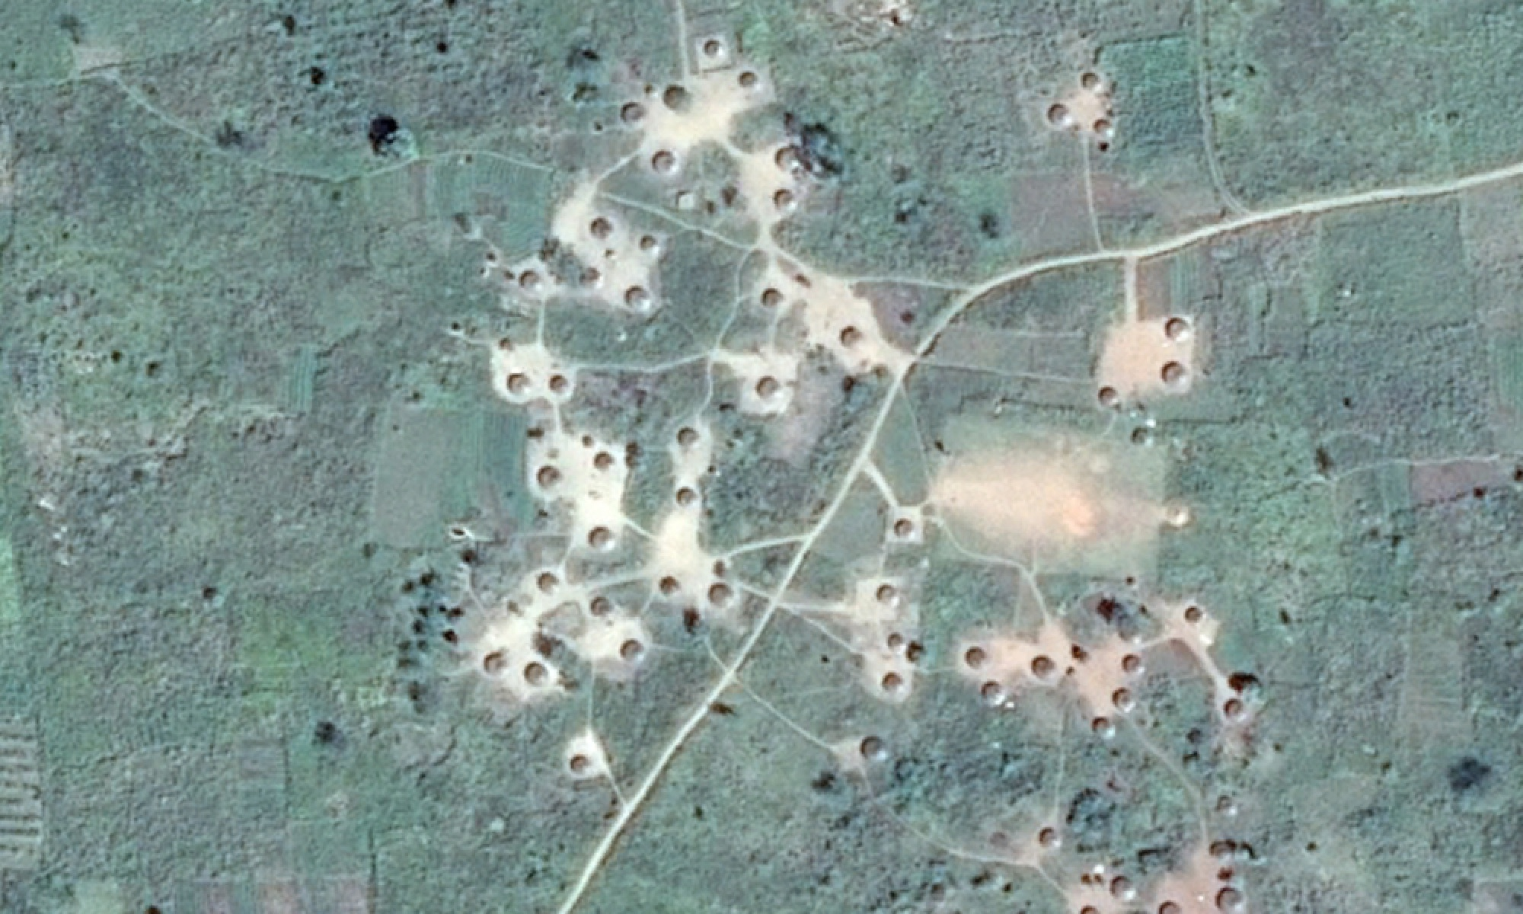
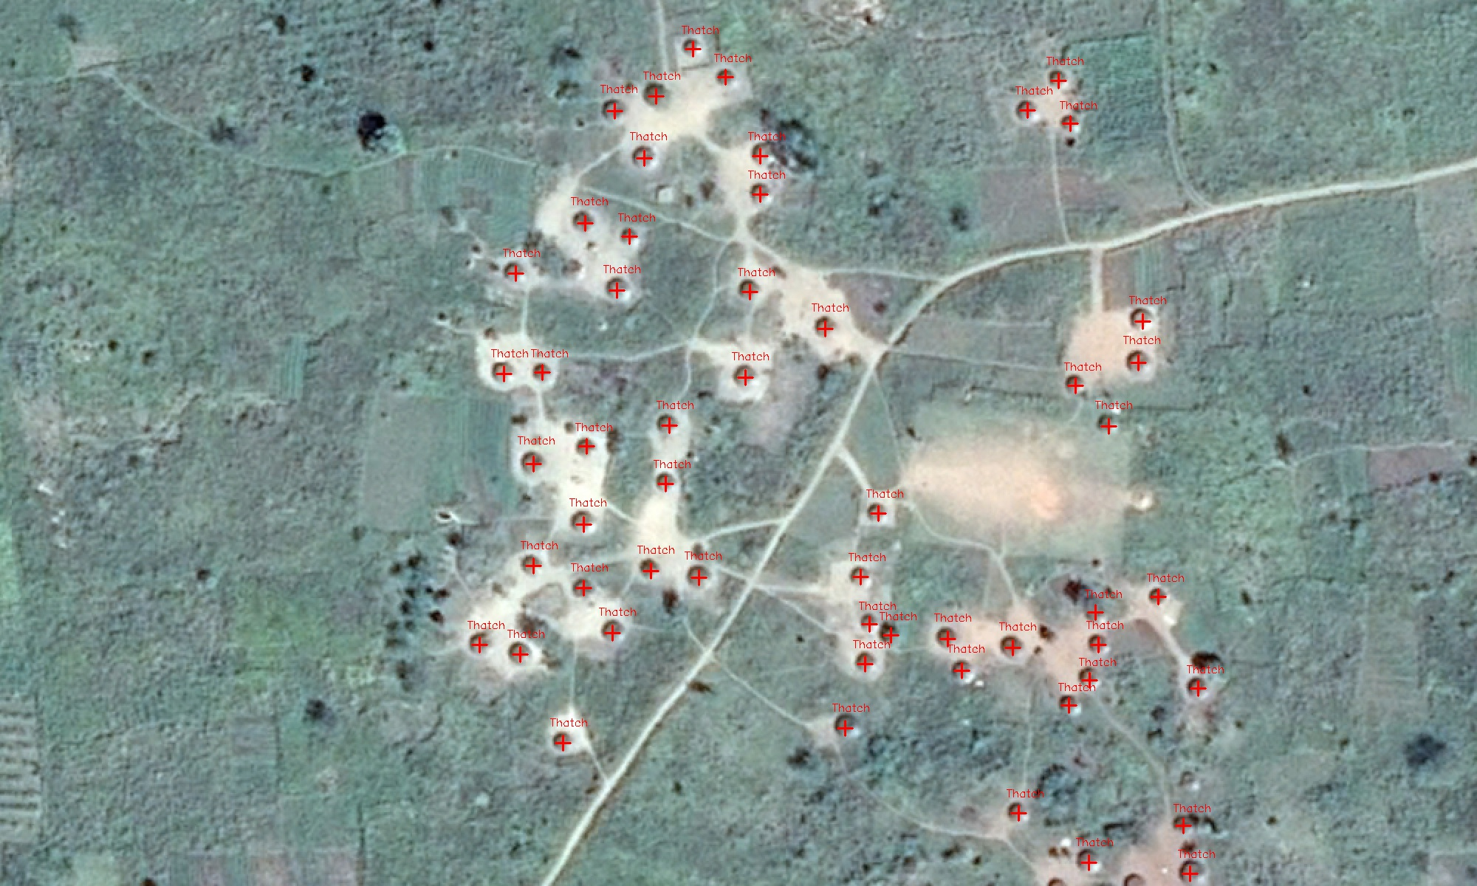

Slide 30
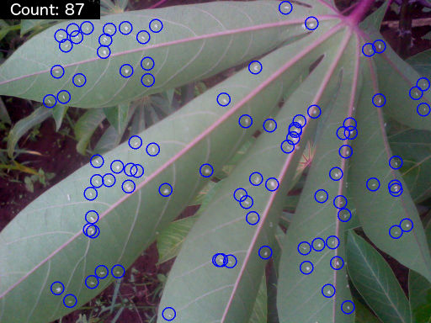
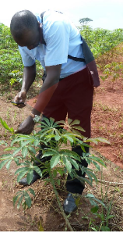
White flies

Slide 31
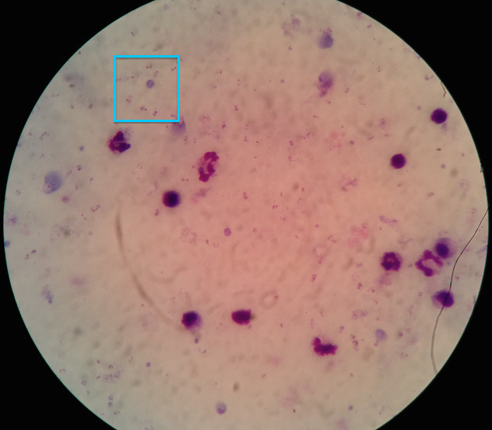
Automatic diagnosis – task at hand and processing data
Notes:
We propose to build an early warning system. The platform will provide alerts in real time on: 1. En route deviation and 2. Delays in time

Slide 32
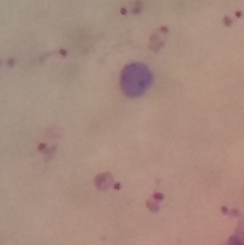

Slide 33
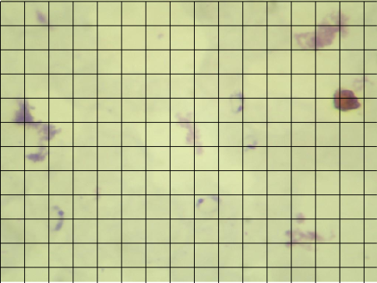

Slide 34
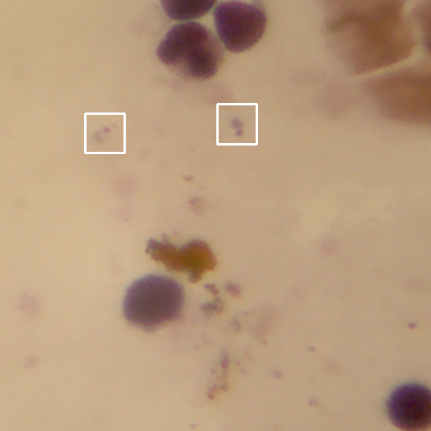
Notes:
We propose to build an early warning system. The platform will provide alerts in real time on: 1. En route deviation and 2. Delays in time

Slide 35
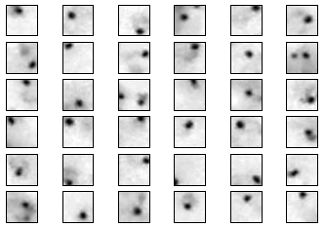
Positive class…

Slide 36
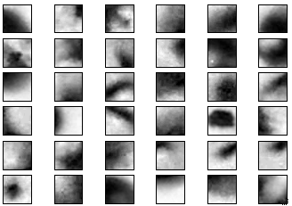
negative class

Slide 37
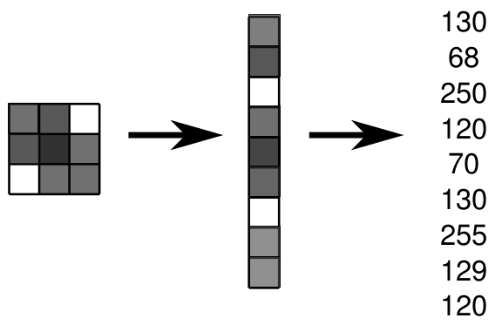
Image data is just grids of numbers, and can be represented
as 1D arrays:
Notes:
We propose to build an early warning system. The platform will provide alerts in real time on: 1. En route deviation and 2. Delays in time

Slide 38
How to proceed from here …

Slide 39
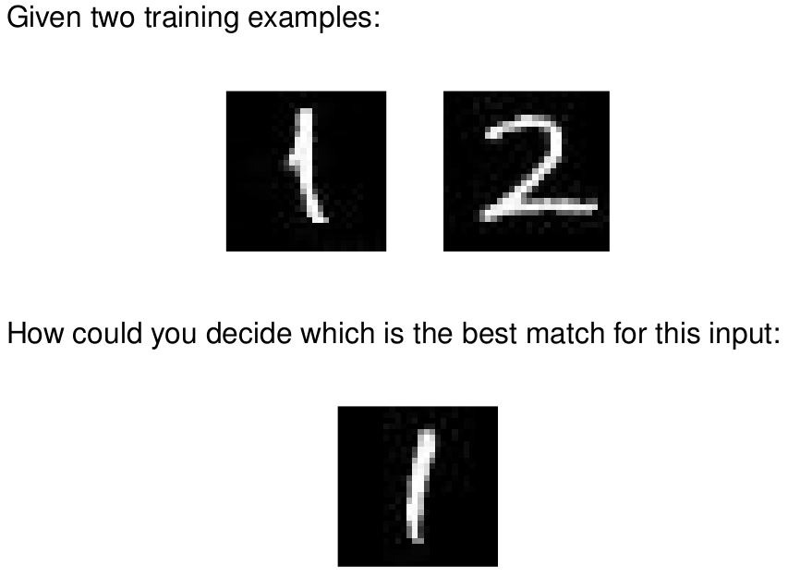
Image data is just grids of numbers, and can be represented
as 1D arrays:

Slide 40
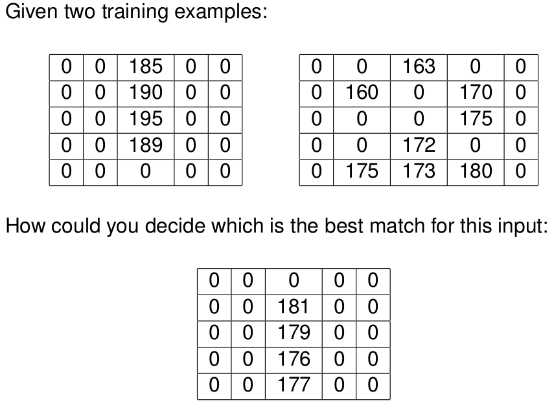
Image data is just grids of numbers, and can be represented
as 1D arrays:

Slide 41
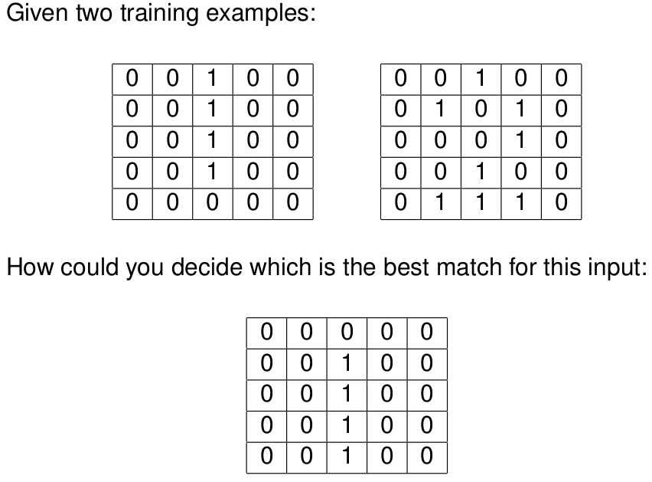
Image data is just grids of numbers, and can be represented
as 1D arrays:

Slide 42
Image data is just grids of numbers, and can be represented
as 1D arrays:

Slide 43
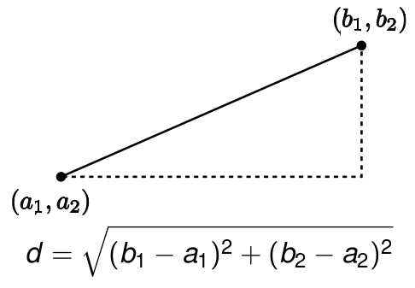
We can use a similarity, or "distance" measure...

Slide 44
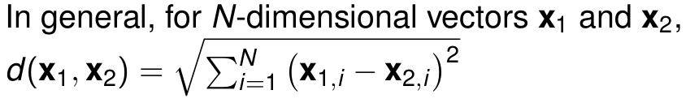
We can use a similarity, or "distance" measure...

Slide 45
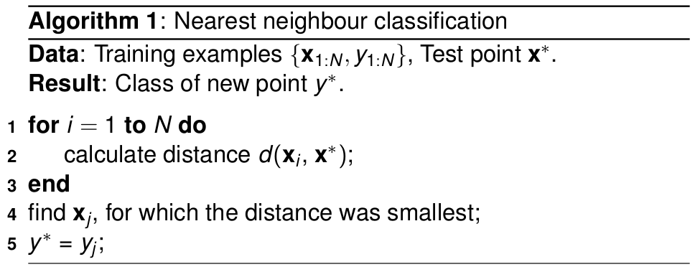
algorithm

